Slide 1
Graphics and Images

Slide 2
introduction
Graphics and images are both non-textual information that can be displayed and printed.
Graphics :
Graphics are normally created in a graphics application and internally represented as an assemblage of objects such as lines, curves, or circles.
Attributes : style, width and color define the appearance of graphics.
Graphic representation is aware of semantic contents. The objects graphics can be composed of can be individually deleted, added, moved, or modified later.

Slide 3
introduction
Images :
Images can be from real world or virtual and are not editable. They ignore the semantic contents.
Images are described as spatial array of values.
The smallest addressable image(picture) element is called a pixel.
The array, and the set of pixels, is called a bitmap.
Object-based editing is not possible, but image editing tools exist for enhancing and retouching bitmap images.
Drawback: need more storage capacity than graphics.
Advantages: no processing is necessary before displaying them.

Slide 4
Capturing graphics and images
The process of capturing digital image depends upon the image’s origin, that is, real world pictures or digital images.
A digital image consists of N lines with M pixels each.
Capturing real world images:
A picture is a 2-D image captured from a real world scene that represent a event from the 3-D spatial world.
Fig shows the camera obscura model of an image capturing system with focal length F (distance b/n the centre of a lens and its focus), where the spatial Cartesian world coordinates[W₁,W₂,W₃] specify the distance of a spatial points from the camera lens.
These points are mapped onto the coordinates of the image level w=[r,s] by applying the central projection equation
r = Fx(W1/W3); s=F x (W2/W3)

Slide 5
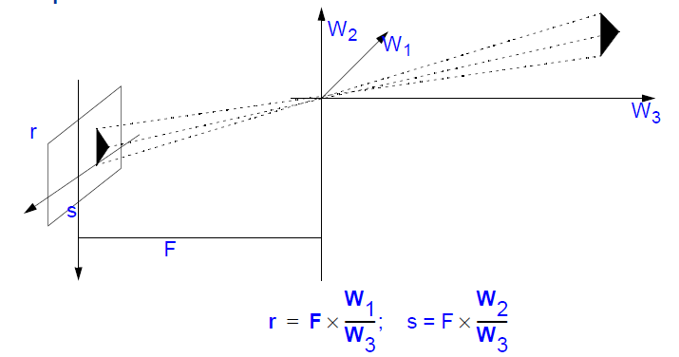

Slide 6
Capturing graphics and images
An image capturing device, converts the brightness signal into an electrical signal.
The first step in processing real world pictures is to sample and digitizes these signals.
The second step involves quantization to achieve an aggregation of color regions to reduce the number of color, depending on the hardware used to output the images.
Video technology normally work with an 8-bit PCM quantization, which means they can represent 2⁸ =256 different colors or gray levels per pixel.

Slide 7
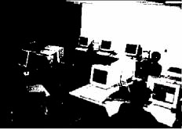
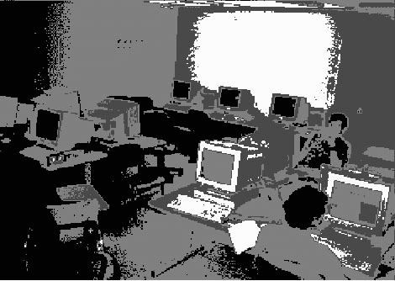
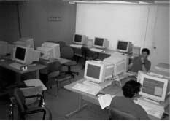
Example
• gray-value images contain different number of brightness levels:
2 levels 4 levels 256 levels

Slide 8
The digitized picture is represented by matrix composed of rows and columns to accommodate numerical values.
If I specifies a two dimensional matrix, then I(r,c) is the brightness value at the position corresponding to row r and column c of the matrix.
Each pixel has a numerical value, i.e., the number of bits available to code a pixel- also called amplitude depth or picture depth.
A numerical value may represent either black(0) or white(1) dot in binary images, or a level of gray in continuous –tone monochromatic images, or the color attributes in color picture.

Slide 9
Image formats
Image format in which the image is created during digitizing process.
Image capturing formats:
The format of the image is defined by two parameters:
The spatial resolution: indicated in pixel
The color encoding: measured in bits per pixel.
The value of the both parameters depends on the hardware and software used to input and output images.

Slide 10
Image formats
Image Storage Formats:
2-dimensional matrix representing pixels
Example: Bitmap: matrix containing binary values
Color image: four important approaches
3 numbers representing intensities for red, green, blue (RGB) or ("true color" if numbers fine-grained enough, e.g., 8-bit; very common)
3 numbers representing pointers to color table (1 color per entry - R,G, or B)
1 number as pointer (index) to color table: "color lookup table CLUT“ (most common, apart from true color)
e.g., 8 bit-pointer: 256 colors possible
e.g., CLUT-entry 3 Bytes: one for each main color (256-out-of-16Mio)
Index to arbitrary data structures representing colors

Slide 11
Image formats
The most popular image storing formats include
PostScript
GIF
XBM
JPEG
TIFF
PBM
BMP

Slide 12
Postscript
History: Developed 1984 by Adobe
First time fonts became important to the general public
Functionality:
Integration of high-quality text, graphics and images
full-fledged programming language optimized for printing graphics and text.
with variables, control structures and files
During its lifetime, PostScript has been developed in levels,
Postscript Level-1:
• Earliest version developed in 1980ies
• Scalable font concept (in contrast to fixed-size fonts available until then)
• Problem: no patterns available to fill edges of letters resulting in medium quality

Slide 13
Postscript Level-2:
High-quality pattern filling
Greater number of graphics primitives
Color concept both device-dependent or device-independent
Postscript Level-3:
Fully optimized printing systems
Advanced features for modern digital document processing.
If you want to include nice PostScript images into a document.
Problem: your page layout needs to know how big the image is and how to move it to the correct place on the page.
Encapsulated PostScript(EPS) is that part of Adobe’s Document Structuring Convention(DSC) that provides this information.

Slide 14
Graphics Interchange Format (GIF)
History:
Developed by CompuServe Information Service in 1987.
Goal
• to exchange images platform-independently
Main components:
• header (identification and version)
• application (creator software of image)
• data
• trailer (end of GIF-data)
Compression: Lempel-Ziv-Algorithm
• localizes bit patterns which occur repeatedly
• variable length-coding of repeated patterns
Comment
• Well-suited for image sequences
(as more than one image can be part of a GIF-file)

Slide 15
Tagged Image File Format (TIFF)
History
• Designed by Aldus Co. and Microsoft
Functionality
to support platform-independent exchange of images
It can save images in an almost infinite number of variations.
Wide distribution as well-suited for scanners and fax devices
Two Main components:
• Baseline part describes the properties that should support display programs.
• Extensions defines properties, i.e., the use of the CMYK color model to represent print colors.

Slide 16
Compression
Various/many color models
• binary images
• gray-value images
• RGB
• palettes
CMYK color model
• various algorithms,
• like Lempel-Ziv, run length encoding (also denoted as PackBits compression),
• FAX groups 3 and 4 and JPEG,
• Huffman encoding
The TIFF format can be used to encode graphical contents in different ways, for ex., to provide thumbnails for quick review of images without the need to open the image file.

Slide 17
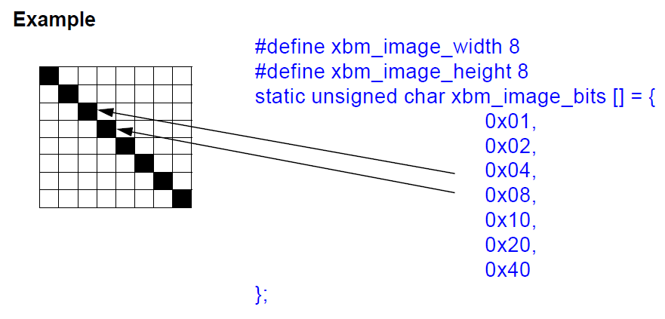
X11 Bitmap (XBM) and X11 Pixmap(XPM)
Used in UNIX world to store program icons or background images.
Allow the definitions of monochrome(XBM) or color(XPM) image inside a program code.
Two formats use no compression for image storage.
Allow encoding of only 256 colors or gray levels.
In the monochrome XBM format, the pixel of an image are encoded and written to a list of byte values in the C prgm lang, grouping 8pixels into a byte value.

Slide 18
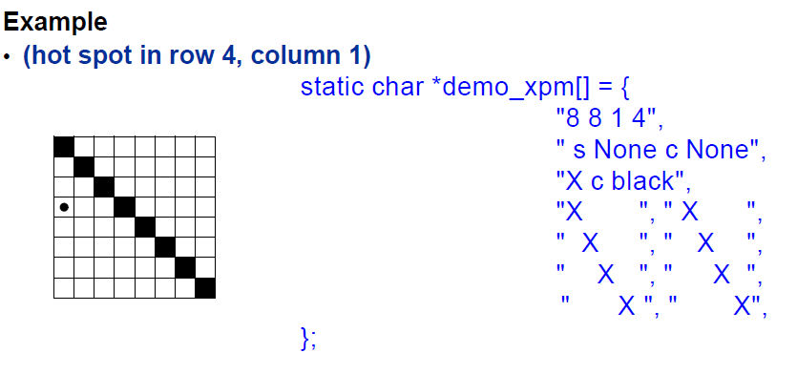
In XPM format, image data are encoded and written to a list of strings(string array), together with a header.
First line: defines image dimension and a hot spot(identifies cursor position(exact pixel) where mouse selection can be applied)
Second line: describes the color used ,replacing a text or RGB color value by a ASCII charater.

Slide 19
Portable Bitmap Plus(PBMplus)
It is a software package that allow conversion of images between various image formats.
PBMplus include four different image formats,
Portable bitmap(PBM) for binary image
Portable Graymap(PGM) for gray value images
Portable Pixmap(PPM) for true color images,
Portable Anymap(PAM) for format-independent manipulation of images.
These formats support both text and binary encoding.
The contents of PBMplus files are the following:
A magic number identifying the file type, i.e.,ex:”P1” for PBM.
Blanks ,tabs, carriage returns, and line feeds.
Decimal ASCII characters that defines the image width, image height.
ASCII numbers plus blanks that specify the maximum value of color components and additional color information.
Filter tools are used to manipulate internal image formats.

Slide 20
Bitmap (BMP)
Used in Windows system.
BMP format is based on the RGB color model.
BMP format defines a header and a data region.
Header region contains information about size, color depth, color table and compression methods.
Data region contains the value of each pixel in a line.

Slide 21
Creating graphics
Input Devices:
Graphical input device includes
Mice(with or without cable)
Tablets, and
Transparent, highly sensitive screens, or input devices that allow three-dimensional or higher dimensional input values, in addition to the x and y positions on the screen, such as
Trackballs
Spaceballs
Data gloves.
Trackballs : Rotate around the vertical axis in addition to the two horizontal axes, but no direct relationship between hand movements on the device and corresponding movement in 3D space.
Spaceballs : Solid ball positioned on an elastic base. Pressing or pulling the ball in any direction produces a 3D translation and a 3D orientation.
Data gloves: Device that senses the hand position and its orientation. It allows pointing to objects, exploring and navigating within screen, or acting at a distance on the real world. With gloves, real objects may be moved at a distance, while the user only monitors their virtual representation.

Slide 22
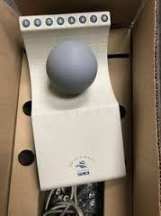
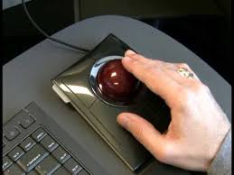
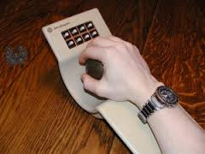
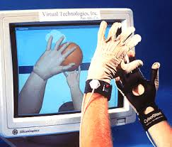
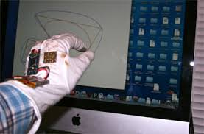
Fig :Trackballs
Fig :Spaceballs
Fig :Spaceballs
Fig :Data Glove
Fig :Data Glove

Slide 23
Creating graphics
Graphics Software:
Graphics are generated by use of interactive graphic system.
Interactive graphics systems is an aggregated view consisting of three software components:
Application model
Application program
Graphics system
Application model:
It represents data or objects to be displayed on the screen and stored in an application database.
The application program processes user input and produces views by sending a series of graphical output commands to the third component, the graphic system.
The graphic system is responsible for image production involving detailed description and for passing user input on to the application program.

Slide 24
Creating graphics
Storing Graphics:
Graphics primitives and their attributes are on a higher image representation level because they are not specified by a pixel matrix.
Drawback: An additional step is required to convert graphics primitives and their attributes into a pixel representation.
Some packages include this type of conversion, for example
SRGP (Simple Raster Graphics Package): generate either a bitmap or a pixmap.
PHIGS(Programmer’s Hierarchical Interactive Graphics System)
GKS(Graphics Kernel System)
Graphics storage formats: important file formats are IGES, DXF, HPGL

Slide 25
Computer assisted graphics and image processing
Image analysis(Image recognition)
Image analysis involves techniques to extract description from images, which are required by methods used to analyze scenes on a higher level.
Applications :
To evaluate photos taken by an air contamination monitor.
Sampled TV pictures of the moon or other planets received from space probes
TV pictures generated by the visual sensor of an industrial robot, X-ray pictures or CAT pictures.
Some image processing fields include image improvement, pattern discovery and recognition , scene analysis, and computer vision.

Slide 26
Computer assisted graphics and image processing
Image analysis: Image Properties
Image recognition methods uses these properties to classify images:
Color
Texture
Edges
Color : Assume image want to analyze in in RGB format with three 8-bit color channel.
Use Color histogram(a graphical representation of the distribution of numerical data.) to acquire the image, i.e., how many pixels of the image take a specific color.
Previously discretize the colors occurring in the image.

Slide 27
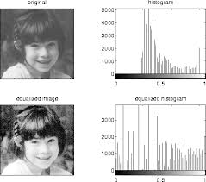
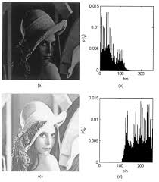

Slide 28
To recognize colorfulness of an image, requires to find a color tends to occur on large surface(in a coherent environment) or in many small spot(in a incoherent environment).
This information will be lost if we were to count only the number of pixels in a specific color.
For this reason, suggest to calculate color coherence vector(CCV).
An advantage of using color as our property to compare two images is that it is robust and can represent slight changes in scaling.

Slide 29
Texture :
Texture is a small surface structure, either natural or artificial, regular or irregular. Ex:- wood barks or veining, knitting patterns, or the surface of sponge.
Two basic approaches:
Structural analysis: searches for small basic components and group these components to form a texture.
Statistical analysis: describe the structure as a whole based on specific attributes,(for example, local gray-level variance, regularity, coarseness, orientation and contrast).
In practical applications, structural methods do not play an important role.
To analyze textures, color images are first converted into a gray-level representation.
Studying natural images:-deal with issue of what structures we want to call a texture(depends on scaling & other factor).
To solve this issue, use regular variations of gray values in small environment as criterion for occurrence of texture in image region.

Slide 30
Edges :
The use of edges to classify images provides a basic method for image analysis- the convolution of an image from a mask.
Convolution mask method uses a given input image, E, to gradually calculate a(zero initialized) output image, A.
Convolution mask( convolution kernel), M, runs across E pixel by pixel and links the entries in the mask at each position that M occupies in E with the gray value of the underlying image dots.
The result of this linkage is written to output image A.

Slide 31
Image segmentation
Segmentation is an operation that assign unique numbers(identifiers) to object pixels based on different intensities or colors in the foreground and background regions of an image.
Segmentation is used to identify related pixel areas, so-called objects, recognition of these objects is not part of the segmentation process.
Segmentation methods are classified as follows:
Pixel –orientated method
Edge –orientated method
Region –orientated method

Slide 32
Pixel –orientated segmentation methods
1. The gray value of a pixel is studied in isolation in this method.
This method acquires the gray- level distribution of an image in a histogram and attempts to find one or several thresholds in this histogram.
If the object we search has one color but different background, then the result is a bimodal histogram with spatially separated maxima.
By setting a threshold at this position, we can divide the histogram into several region.
2. Alternatively, we could segment on the basis of color values.
In this case, we modify the method to the three-dimensional space so that pixel clouds and be separated.

Slide 33
In practical applications, this method has several drawbacks:
Bimodal distribution hardly occurs in nature and digitization error prevents it in almost all cases.
If the object and background histograms overlap, then the pixels of overlapping regions cannot be allocated.
To function properly, image are edited manually. Involves marking the regions that can be segmented by use of local histograms.
Edge –orientated segmentation methods
Edge –orientated segmentation methods work in two steps:
The edge of an image are extracted.
The edges are connected so that they form closed contours around the objects to be extracted.

Slide 34
Region –orientated segmentation methods
Neighboring pixels normally have similar properties. This aspect is not taken into account in the pixel- and edge- oriented methods.
In contrast, region growing methods consider this aspect by starting with a “seed” pixel.
Successively, the pixels neighbors are included if they have some similarity to the seed pixel.
Water –inflow segmentation:
Previous section Described local and global segmentation strategies.
A more efficient segmentation can be achieved by combining the local and global approaches.
The basic idea

Slide 35
Image recognition
Image segmentation describes properties that can be used to classify the content of an image.
Image recognition describes the entire process required for object recognition.

Slide 36
Source image
Intermediate images
Formatting
Observed images
Conditioning
Conditioned images
Logical image data Structure
Marketing
Marked images
Grouping
Grouped images
Symbolic representation
Extraction
Logical data Structure
Extracted images
Target images
Matching

Slide 37
Image Formatting
Image Formatting means capturing an image by bringing it into a digital form.
Conditioning
In an image, there are usually features which are uninteresting, either because they were introduced into the image during the digitization process as noise, or because they form part of a background.
An observed image is composed of informative patterns modified by uninteresting random variations.
Conditioning suppresses, or normalizes, the uninteresting variations in the image, effectively highlighting the interesting parts of the image.

Slide 38
Labeling
Informative patterns in an image have structure.
Patterns are usually composed of adjacent pixels which share some property such that it can be inferred that they are part of the same structure (e.g., an edge).
Edge detection techniques focus on identifying continuous adjacent pixels which differ greatly in intensity or colour, because these are likely to mark boundaries, between objects, or an object and the background, and hence form an edge.
After the edge detection process is complete, many edge will have been identified. However, not all of the edges are significant.
Thesholding filters out insignificant edges. The remaining edges are labeled.
More complex labeling operations may involve identifying and labeling shape primitives and corner finding.

Slide 39
Grouping
Labeling finds primitive objects, such as edges. Grouping can turn edges into lines by determining that different edges belong to the same spatial event.
The first 3 operations represent the image as a digital image data structure (pixel information), however, from the grouping operation the data structure needs also to record the spatial events to which each pixel belongs.
This information is stored in a logical data structure.

Slide 40
Extracting
Grouping only records the spatial event(s) to which pixels belong.
Feature extraction involves generating a list of properties for each set of pixels in a spatial event. These may include a set's centroid, area, orientation, spatial moments, grey tone moments, spatial-grey tone moments, circumscribing circle, inscribing circle, etc.
Additionally properties depend on whether the group is considered a region or an arc. If it is a region, then the number of holes might be useful. In the case of an arc, the average curvature of the arc might be useful to know. Feature extraction can also describe the topographical relationships between different groups. Do they touch? Does one occlude another? Where are they in relation to each other?

Slide 41
Matching
Finally, once the pixels in the image have been grouped into objects and the relationship between the different objects has been determined, the final step is to recognise the objects in the image.
Matching involves comparing each object in the image with previously stored models and determining the best match template matching.

Slide 42
Reconstructing images
The method used to reconstruct images are
The Randon Transform
Stereoscopy

Slide 43
Basics
Representation of Video signals
In conventional black-and-white television sets, the video signal is generated by means of a cathode Ray Tube(CRT).
The representation of a video signal comprises three aspects: Visual representation, Transmission, and digitization.
Visual Representation:
A key goal is to present the observer with as realistic as possible a representation of a scene.
To achieve this goal, the television picture has to accurately convey the spatial and temporal content of the scene.

Slide 44
Important measure are
Vertical details and viewing distance
Horizontal detail and picture width
Total detail content of a picture
Depth perception
Luminance
Temporal aspect of illumination
Continuity of motion
Flicker

